Slide 1
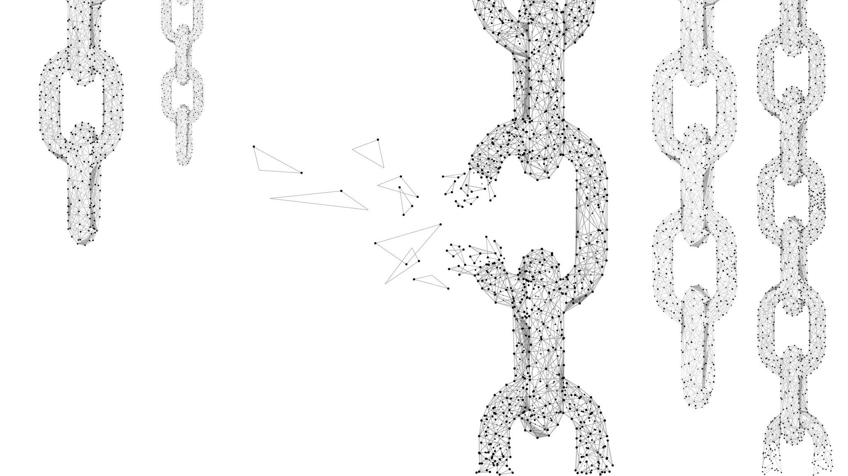
Transport in 1D Quantum Systems Beyond Diffusion
Kevin Wang, Joel Moore
UC Berkeley
Kavli ENSI Retreat 2025

Slide 2
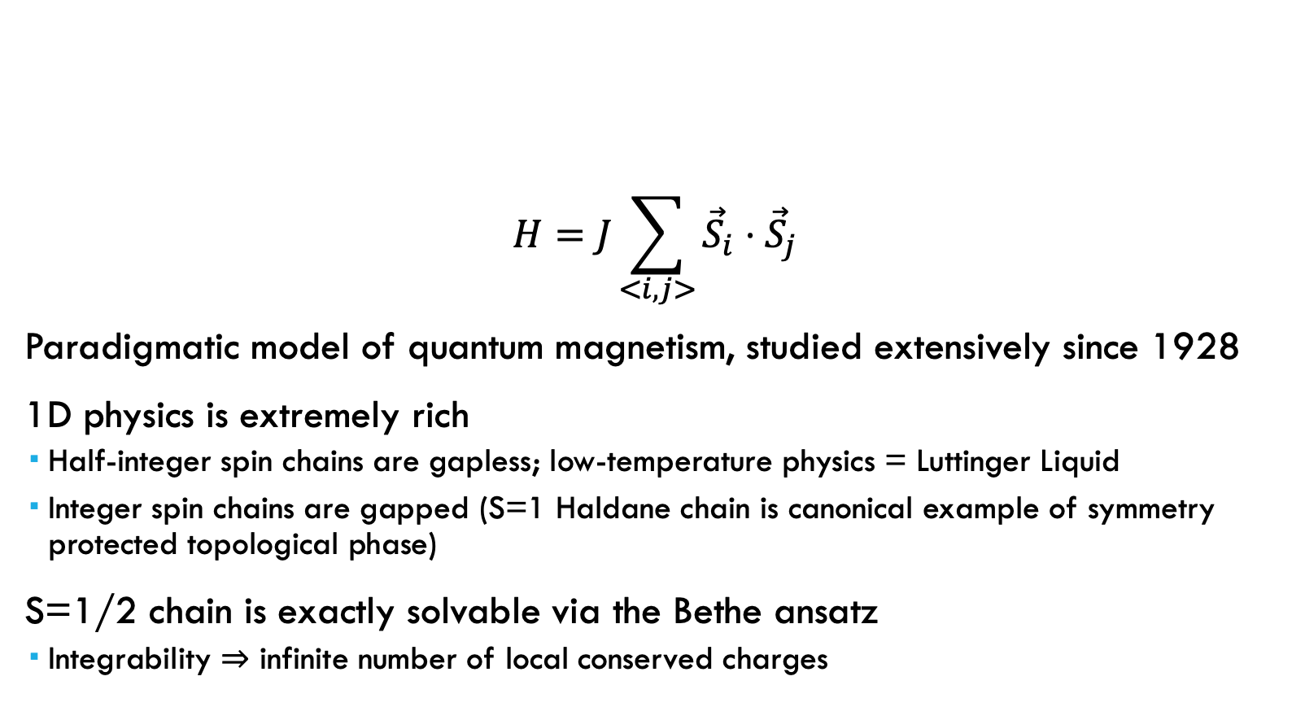
Quantum Heisenberg Model
$$H=J\sum_{<i,j>}{{\vec{S}}_{i}}⋅{\vec{S}}_{j}$$
Paradigmatic model of quantum magnetism, studied extensively since 1928
1D physics is extremely rich
Half-integer spin chains are gapless; low-temperature physics = Luttinger Liquid
Integer spin chains are gapped (S=1 Haldane chain is canonical example of symmetry protected topological phase)
S=1/2 chain is exactly solvable via the Bethe ansatz
Integrability $⇒$ infinite number of local conserved charges

Slide 3
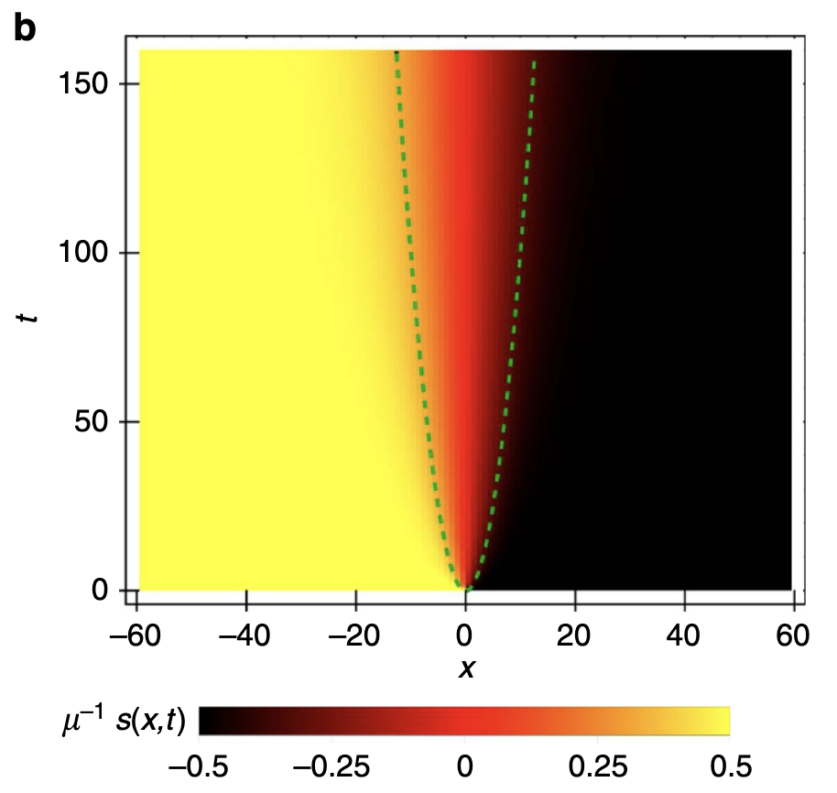
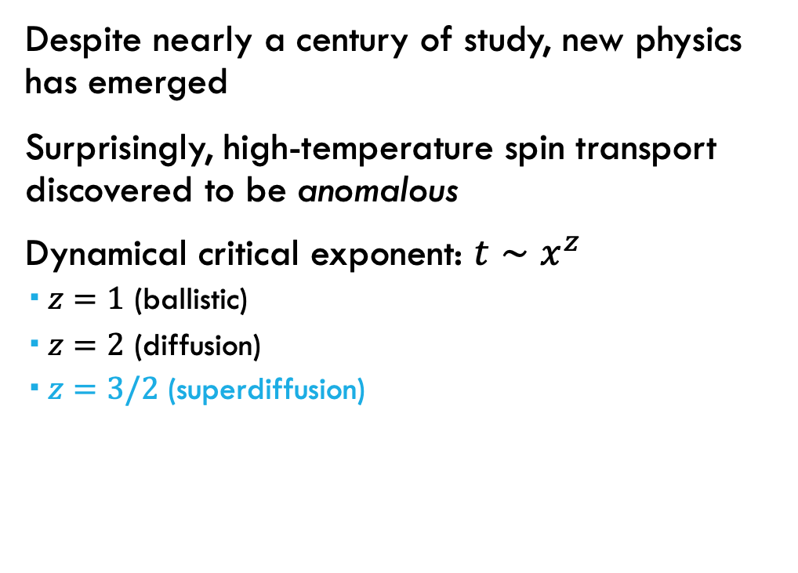

S=1/2 Heisenberg Chain: Anomalous Spin Transport
Despite nearly a century of study, new physics has emerged
Surprisingly, high-temperature spin transport discovered to be anomalous
Dynamical critical exponent: $t∼x^{z}$
$z=1$ (ballistic)
$z=2$ (diffusion)
$z=3/2$ (superdiffusion)
$$x \sim t^{2/3}$$
Ljubotina, Žnidarič & Prosen, ‘17

Slide 4
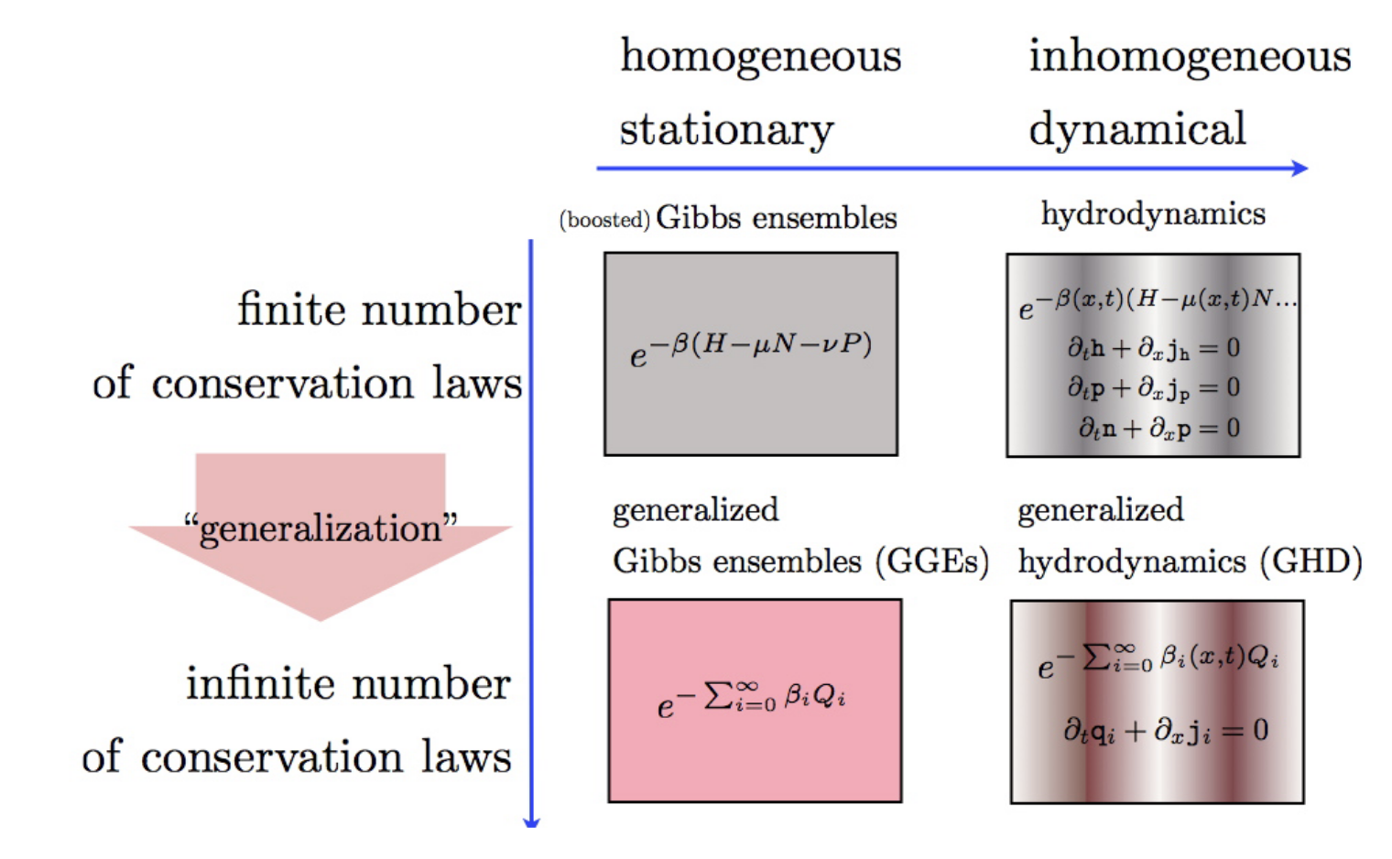
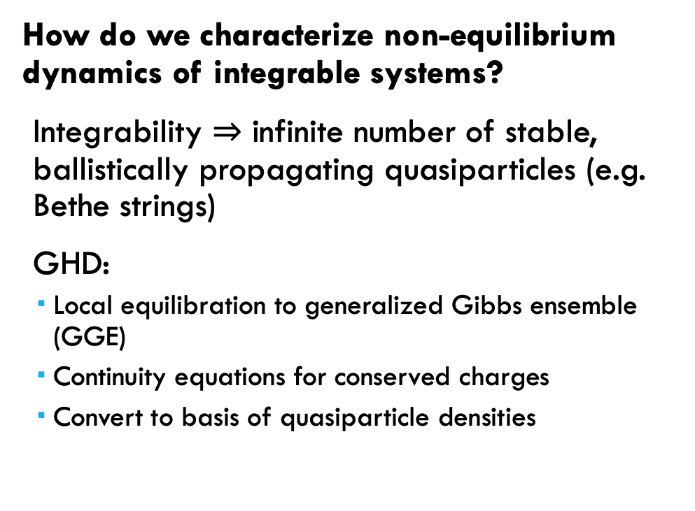
Generalized Hydrodynamics (GHD)
How do we characterize non-equilibrium dynamics of integrable systems?
Integrability $⇒$ infinite number of stable, ballistically propagating quasiparticles (e.g. Bethe strings)
GHD:
Local equilibration to generalized Gibbs ensemble (GGE)
Continuity equations for conserved charges
Convert to basis of quasiparticle densities
Doyon, SciPost Phys. Lect. Notes, ‘20
Notes:
Infinite conservation laws, failure to thermalize

Slide 5
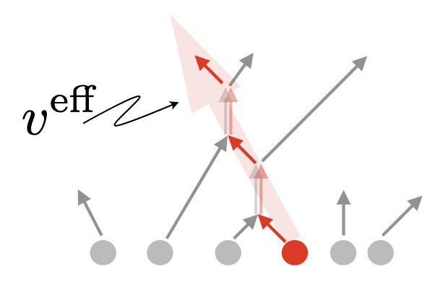
Generalized Hydrodynamics (GHD)
Intuitive picture: quasiparticles travel ballistically with effective velocity and charge dressed (renormalized) by elastic collisions with other quasiparticles
Doyon, SciPost Phys. Lect. Notes, ‘20
Notes:
Infinite conservation laws, failure to thermalize

Slide 6
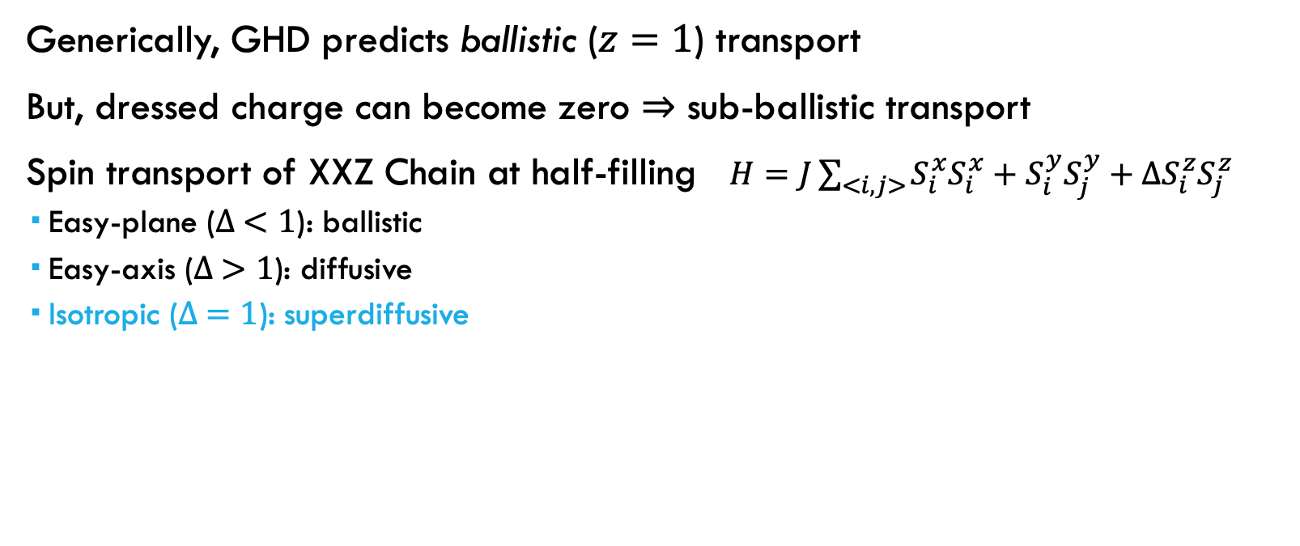
S=1/2 Heisenberg Chain: Anomalous Spin Transport
Generically, GHD predicts ballistic ($z=1$) transport
But, dressed charge can become zero $⇒$ sub-ballistic transport
Spin transport of XXZ Chain at half-filling $H=J\sum_{<i,j>}{S_{i}^{x}S_{i}^{x}+S_{i}^{y}S_{j}^{y}+ΔS_{i}^{z}S_{j}^{z}}$
Easy-plane ($∆ <1$): ballistic
Easy-axis ($∆ >1$): diffusive
Isotropic ($∆ =1$): superdiffusive

Slide 7
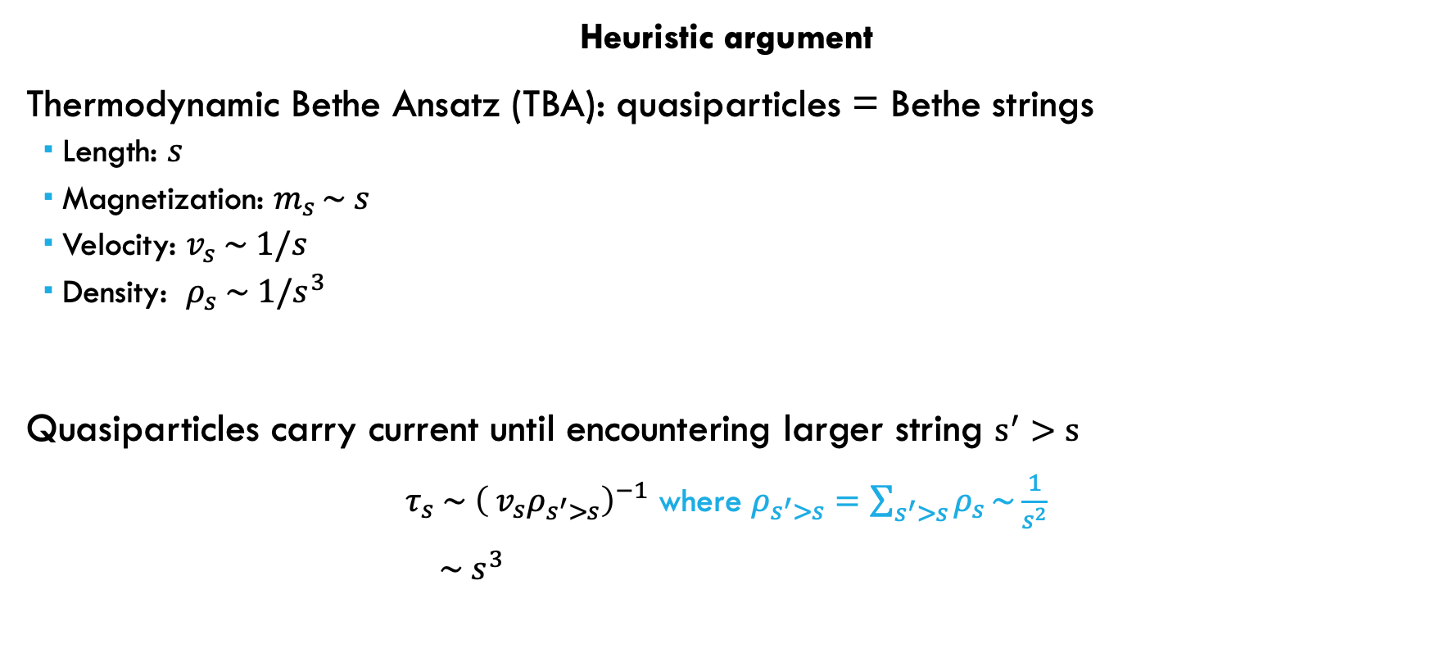
Why superdiffusion?
Heuristic argument
Thermodynamic Bethe Ansatz (TBA): quasiparticles = Bethe strings
Length: $s$
Magnetization: $m_{s }\sim s$
Velocity: $v_{s} \sim 1/s$
Density: $ρ_{s} \sim 1/s^{3}$
Quasiparticles carry current until encountering larger string $s^{′}>s$
$τ_{s} \sim {\left({ v}_{s}ρ_{s^{′}>s}\right)}^{−1}$ where $ρ_{s^{′}>s}=\sum_{s^{′}>s}{ρ_{s}}\sim \frac{1}{s^{2}}$
$\sim s^{3}$

Slide 8
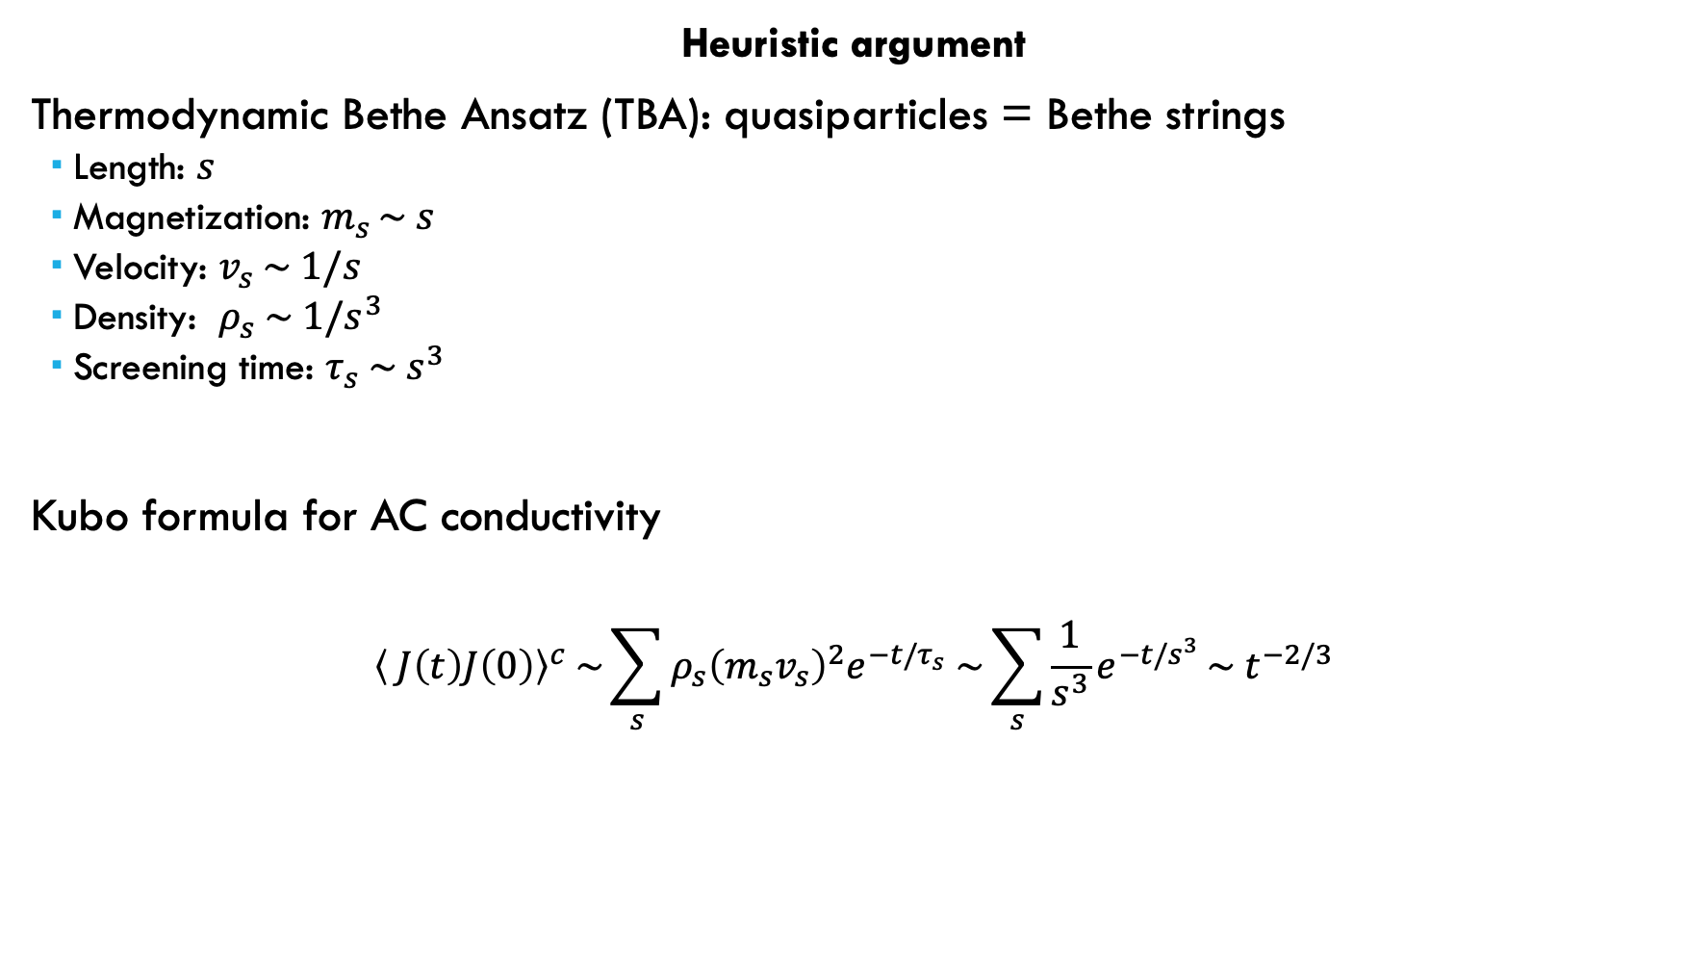
Why superdiffusion?
Heuristic argument
Thermodynamic Bethe Ansatz (TBA): quasiparticles = Bethe strings
Length: $s$
Magnetization: $m_{s }\sim s$
Velocity: $v_{s} \sim 1/s$
Density: $ρ_{s} \sim 1/s^{3}$
Screening time: $τ_{s} \sim s^{3}$
Kubo formula for AC conductivity
$${\left\langle J\left(t\right)J\left(0\right)\right\rangle }^{c} \sim \sum_{s}{ρ_{s}{\left(m_{s}v_{s}\right)}^{2}e^{−t/τ_{s}} \sim \sum_{s}{\frac{1}{s^{3}}e^{−t/s^{3}}}\sim { t}^{−2/3}}$$

Slide 9
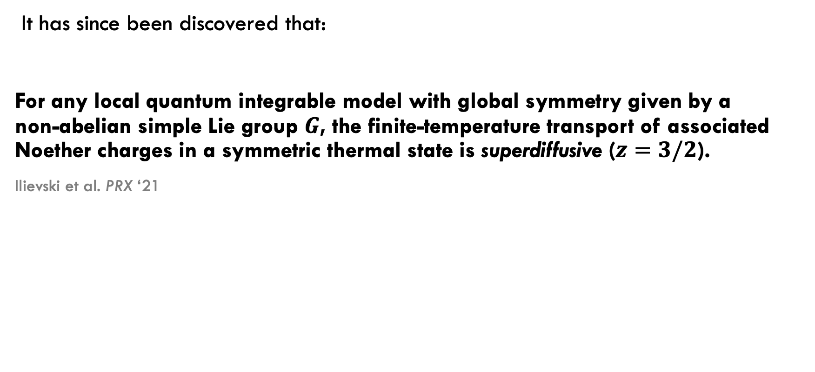
“Superuniversality” of superdiffusion
It has since been discovered that:
For any local quantum integrable model with global symmetry given by a non-abelian simple Lie group $G$, the finite-temperature transport of associated Noether charges in a symmetric thermal state is superdiffusive ($z=3/2$).
Ilievski et al. PRX ‘21

Slide 10
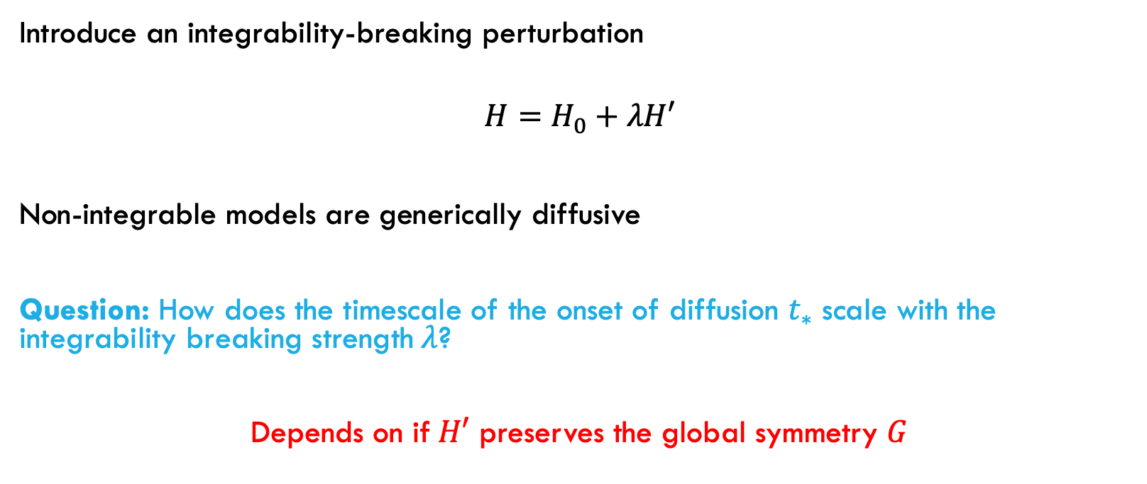
Breaking integrability
Introduce an integrability-breaking perturbation
$$H=H_{0}+λH′$$
Non-integrable models are generically diffusive
Question: How does the timescale of the onset of diffusion $t_{∗}$ scale with the integrability breaking strength$λ$?
Depends on if$H′$ preserves the global symmetry $G$

Slide 11
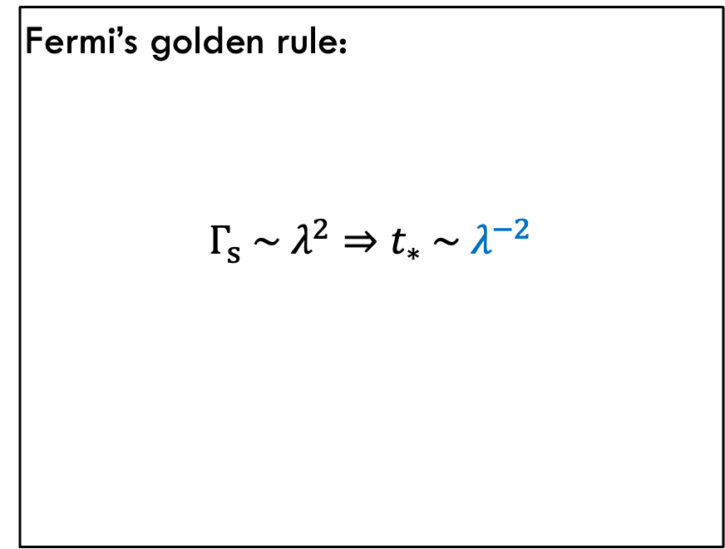

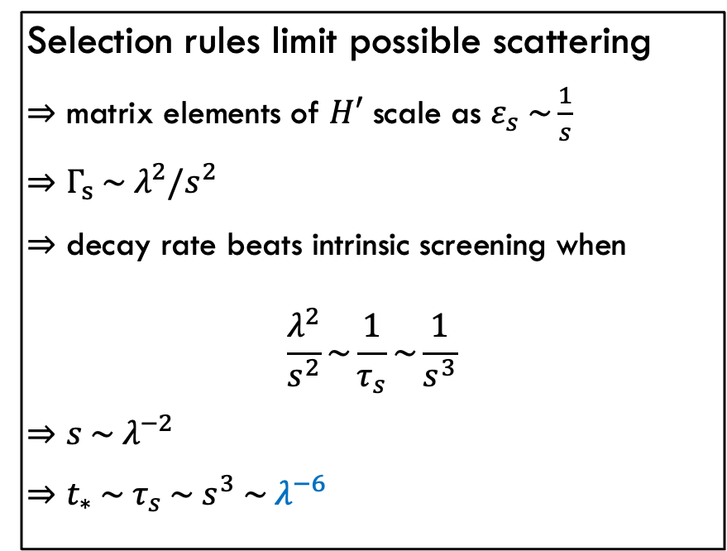

Breaking integrability
$H′$ breaks $G$
$H′$ preserves $G$
Fermi’s golden rule:
$$Γ_{s} \sim λ^{2}⇒t_{∗} \sim λ^{−2}$$
Selection rules limit possible scattering
$⇒$ matrix elements of $H′$ scale as $ε_{s} \sim \frac{1}{s}$
$⇒$ $Γ_{s} \sim λ^{2}/s^{2}$
$⇒$ decay rate beats intrinsic screening when
$$\frac{λ^{2}}{s^{2}}\sim \frac{1}{τ_{s}}\sim \frac{1}{s^{3}}$$
$⇒$ $s \sim λ^{−2}$
$⇒$ $t_{∗} \sim τ_{s} \sim s^{3} \sim λ^{−6}$

Slide 12
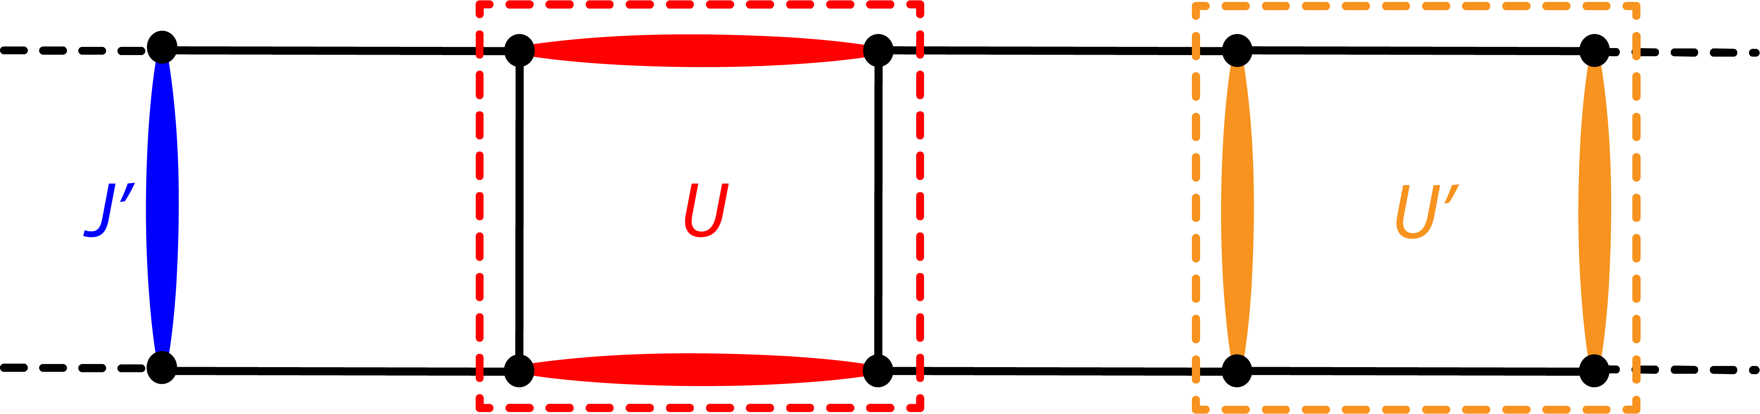
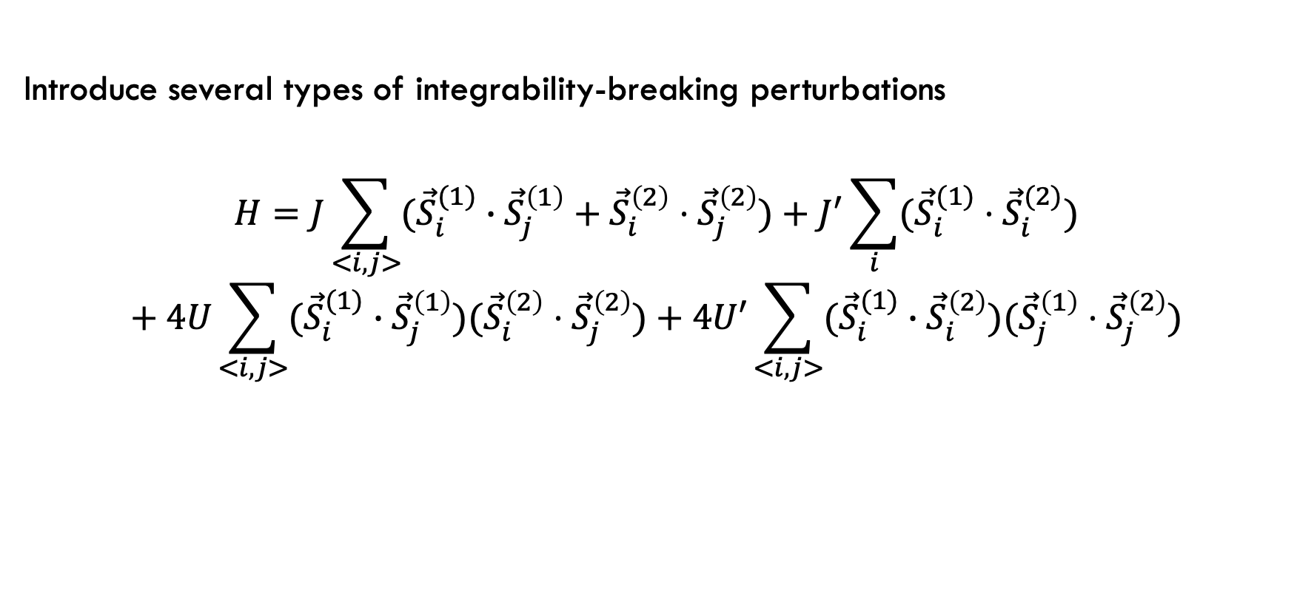
Heisenberg ladder
Introduce several types of integrability-breaking perturbations
$$H=J\sum_{<i,j>}{({\vec{S}}_{i}^{(1)}}∙{\vec{S}}_{j}^{\left(1\right)}+{\vec{S}}_{i}^{\left(2\right)}⋅{\vec{S}}_{j}^{\left(2\right)})+J^{′}\sum_{i}{({\vec{S}}_{i}^{(1)}⋅{\vec{S}}_{i}^{(2)})}$$
$$+ 4U\sum_{<i,j>}{({\vec{S}}_{i}^{(1)}}∙{\vec{S}}_{j}^{\left(1\right)})({\vec{S}}_{i}^{\left(2\right)}⋅{\vec{S}}_{j}^{\left(2\right)})+4U′\sum_{<i,j>}{({\vec{S}}_{i}^{(1)}}∙{\vec{S}}_{i}^{\left(2\right)})({\vec{S}}_{j}^{\left(1\right)}⋅{\vec{S}}_{j}^{\left(2\right)})$$

Slide 13

Heisenberg ladder
Consider two integrable points to perturb around:
$J^{′}=U=U^{′}=0$
$$H_{0}=J\sum_{<i,j>}{({\vec{S}}_{i}^{(1)}}∙{\vec{S}}_{j}^{\left(1\right)}+{\vec{S}}_{i}^{\left(2\right)}⋅{\vec{S}}_{j}^{\left(2\right)})$$
$$G=SU\left(2\right) × SU(2)$$

Slide 14
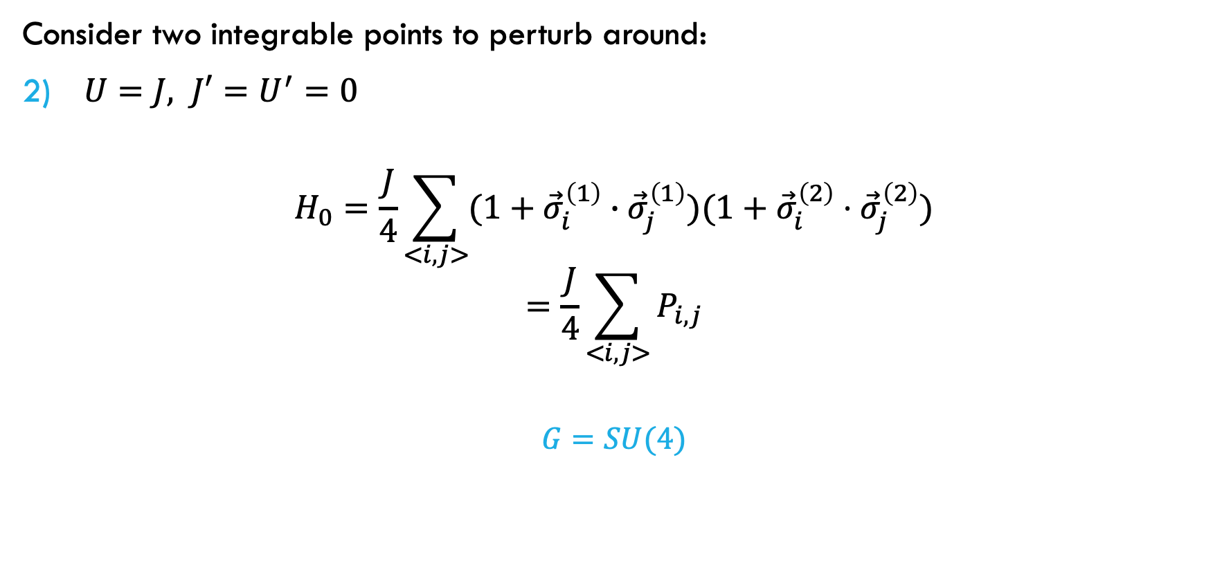
Heisenberg ladder
Consider two integrable points to perturb around:
$U=J, J′=U^{′}=0$
$$H_{0}=\frac{J}{4}\sum_{<i,j>}{(1+{\vec{σ}}_{i}^{\left(1\right)}}∙{\vec{σ}}_{j}^{\left(1\right)})(1+{\vec{σ}}_{i}^{\left(2\right)}⋅{\vec{σ}}_{j}^{\left(2\right)})$$
$$=\frac{J}{4}\sum_{<i,j>}{P_{i,j}}$$
$$G=SU(4)$$

Slide 15
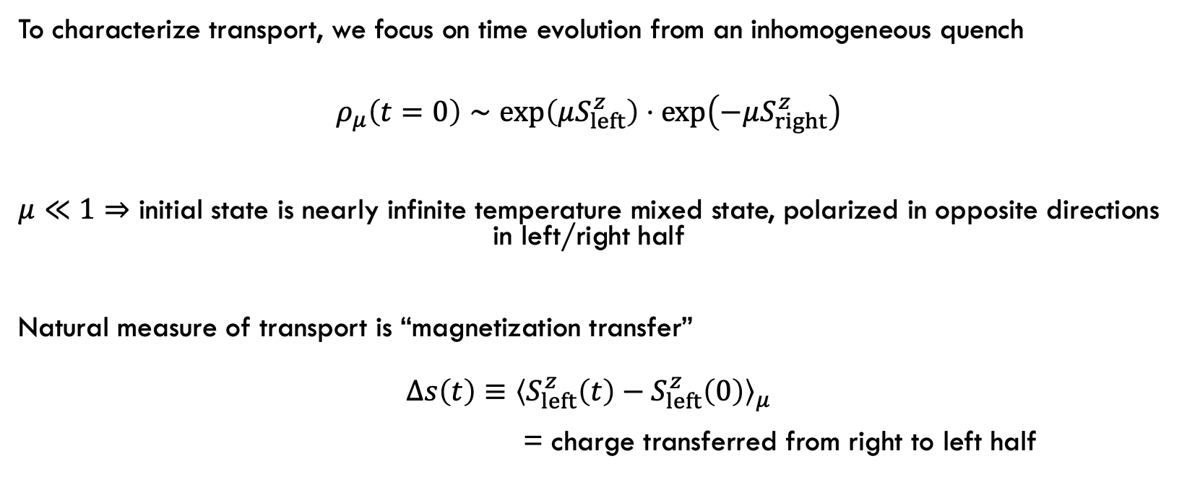
Spin Transport
To characterize transport, we focus on time evolution from an inhomogeneous quench
$$ρ_{μ}\left(t=0\right)∼\exp\left(μS_{left}^{z}\right)⋅\exp\left(−μS_{right}^{z}\right)$$
$μ≪1⇒$ initial state is nearly infinite temperature mixed state, polarized in opposite directions in left/right half
Natural measure of transport is “magnetization transfer”
$$Δs\left(t\right)≡{\left\langle S_{left}^{z}\left(t\right)−S_{left}^{z}\left(0\right)\right\rangle }_{μ}$$
= charge transferred from right to left half

Slide 16
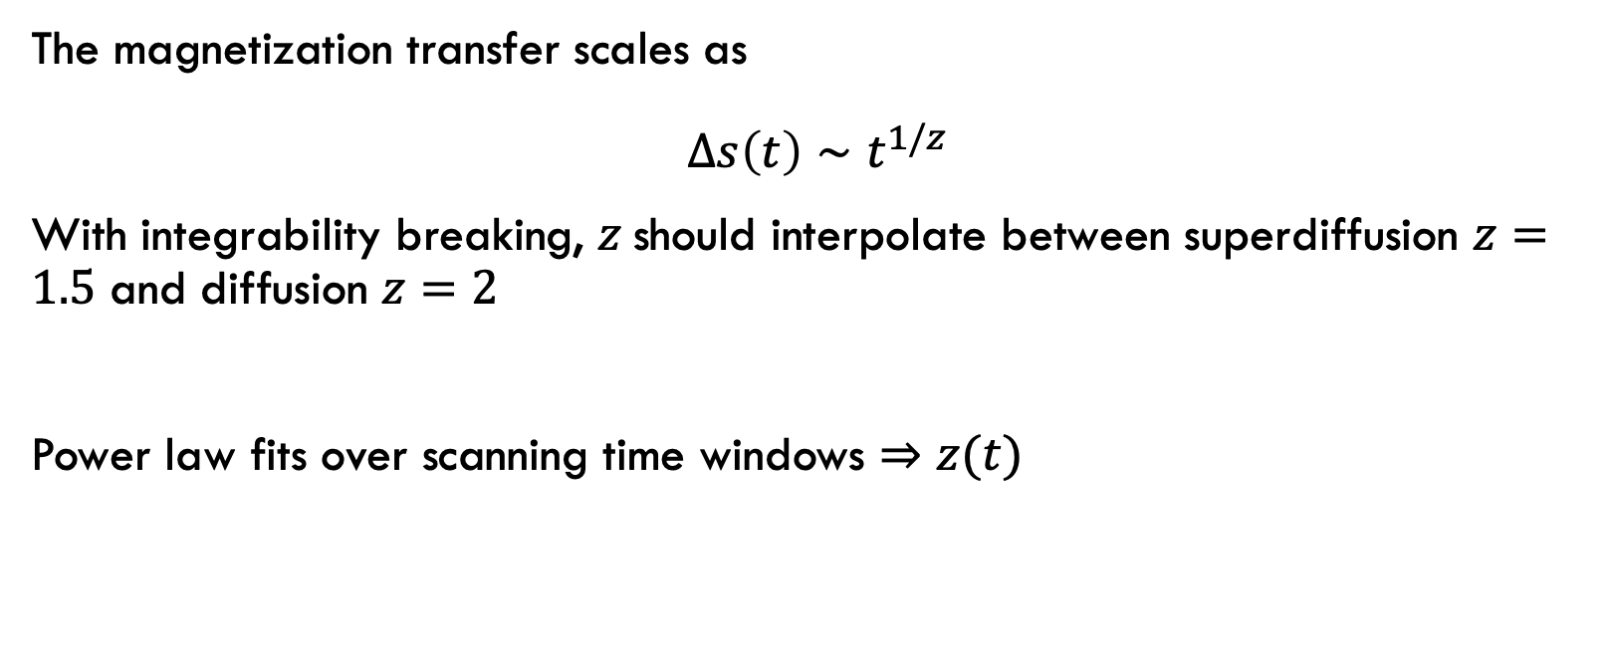
Spin Transport
The magnetization transfer scales as
$$Δs\left(t\right)∼t^{1/z}$$
With integrability breaking, $z$should interpolate between superdiffusion $z=1.5$ and diffusion $z=2$
Power law fits over scanning time windows $⇒$ $z(t)$

Slide 17


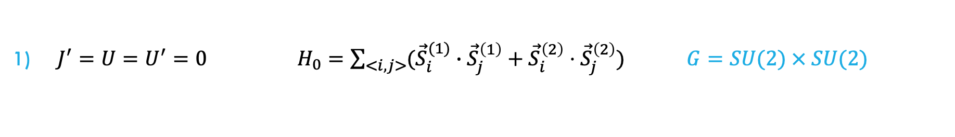

Spin Transport
$J^{′}=U=U^{′}=0 H_{0}=\sum_{<i,j>}{({\vec{S}}_{i}^{(1)}}∙{\vec{S}}_{j}^{\left(1\right)}+{\vec{S}}_{i}^{\left(2\right)}⋅{\vec{S}}_{j}^{\left(2\right)}) G=SU(2) × SU(2)$
$G$-breaking
$G$-breaking
$G$-invariant

Slide 18
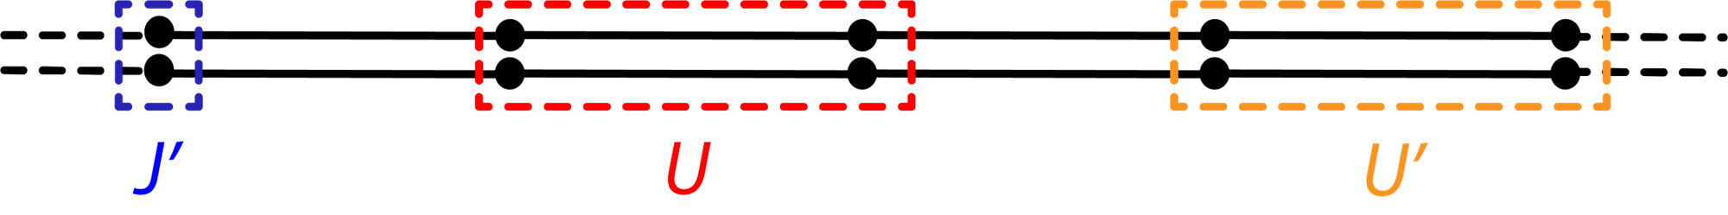
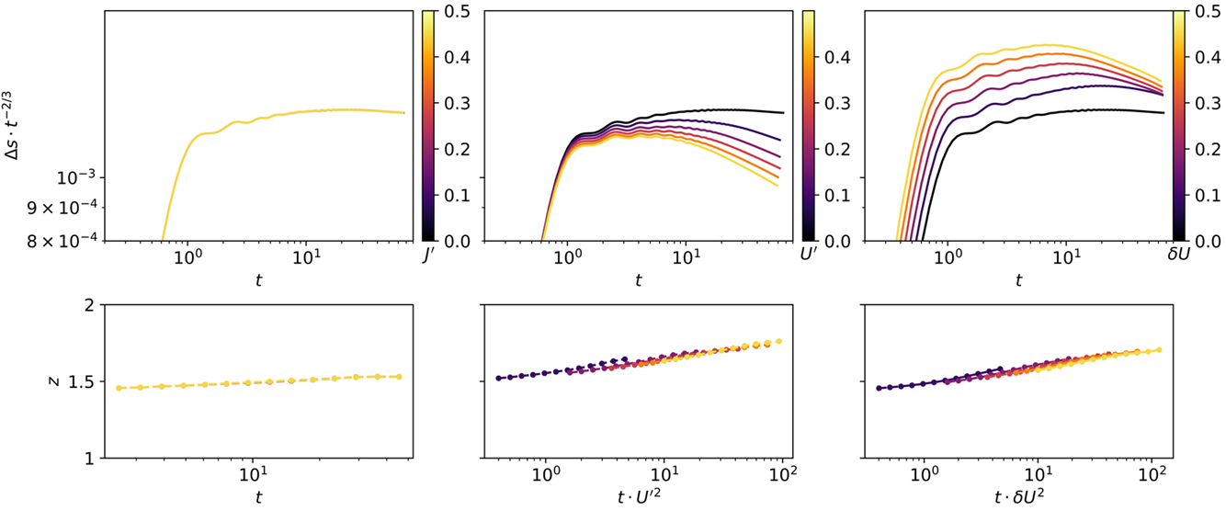


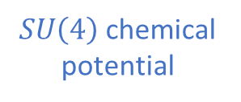
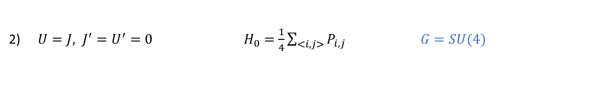
Spin Transport
$U=J, J^{′}=U^{′}=0 { H}_{0}=\frac{1}{4}\sum_{<i,j>}{P_{i,j}}$ $G=SU(4)$
$SU\left(4\right)$chemical potential
$G$-breaking
$G$-breaking

Slide 19
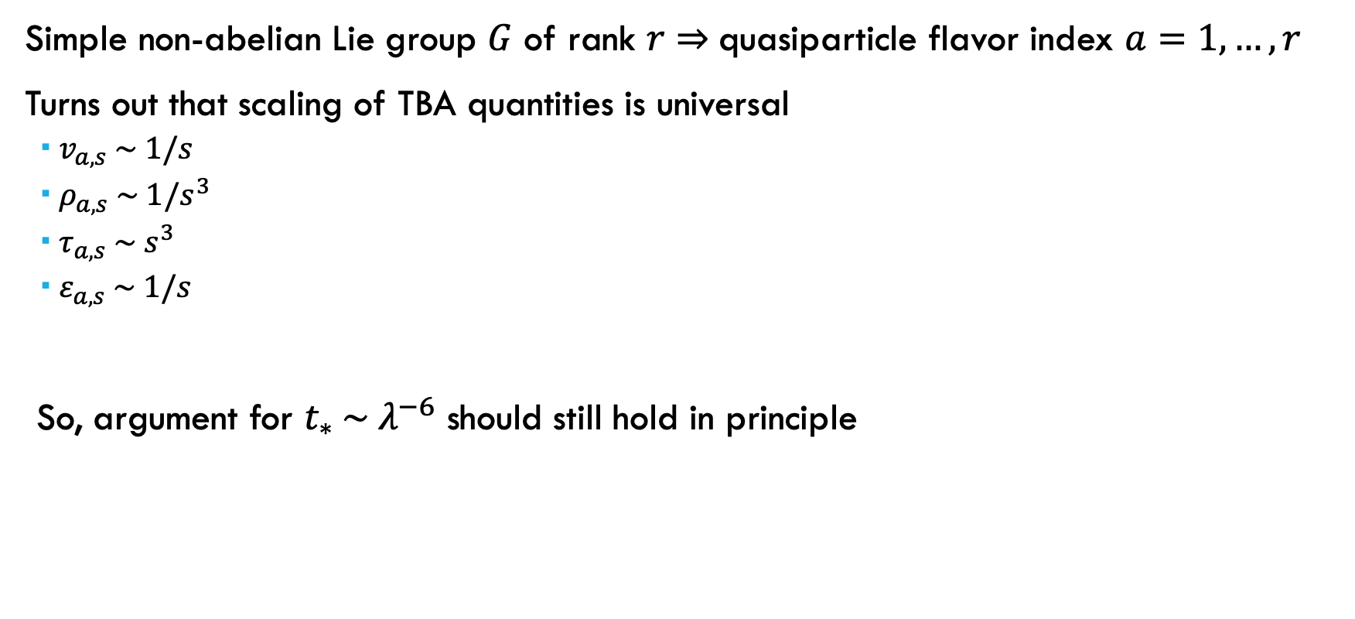
Superuniversal 𝐺-invariant behavior?
Simple non-abelian Lie group $G$ of rank $r⇒$quasiparticle flavor index $a=1,…,r$
Turns out that scaling of TBA quantities is universal
$v_{a,s} \sim 1/s$
$ρ_{a,s} \sim 1/s^{3}$
$τ_{a,s} \sim s^{3}$
$ε_{a,s} \sim 1/s$
So, argument for $t_{∗} \sim λ^{−6}$ should still hold in principle

Slide 20
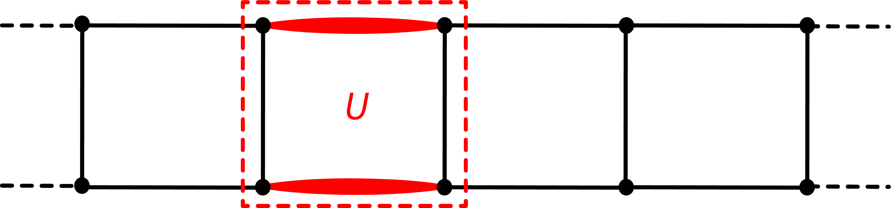
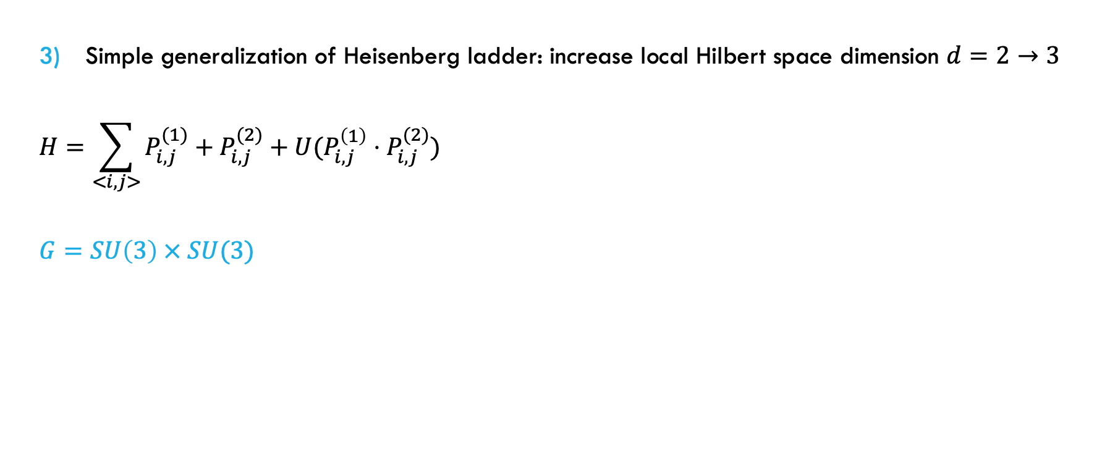
Spin Transport
Simple generalization of Heisenberg ladder: increase local Hilbert space dimension $d=2→3$
$$H=\sum_{<i,j>}{P_{i,j}^{(1)}+P_{i,j}^{(2)}+U(P_{i,j}^{\left(1\right)}⋅P_{i,j}^{(2)})}$$
$$G=SU\left(3\right) × SU(3)$$

Slide 21
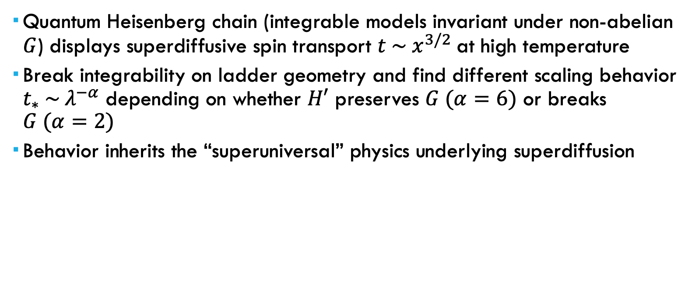
Summary
Quantum Heisenberg chain (integrable models invariant under non-abelian $G$) displays superdiffusive spin transport $t \sim x^{3/2}$at high temperature
Break integrability on ladder geometry and find different scaling behavior $t_{∗} \sim λ^{−α}$ depending on whether $H′$ preserves $G (α=6)$ or breaks $G (α=2)$
Behavior inherits the “superuniversal” physics underlying superdiffusion

Slide 22
Future Directions
Materials Synthesis: S=1/2 spin chains in nanoribbons
Topological graphene nanoribbons (Cao, Zhao, & Louie PRL ’17)
Edge theory of zigzag nanoribbons (Koop, C. & Schmidt, M. J. PRB ’14)
Nanographene Olympicene chains (Zhao et al. Nat. Mater. ‘25)
Molecular chains (Sun et al. Science Advances ’25)
Synthesize effective Heisenberg ladders with tunable interactions?

Slide 23
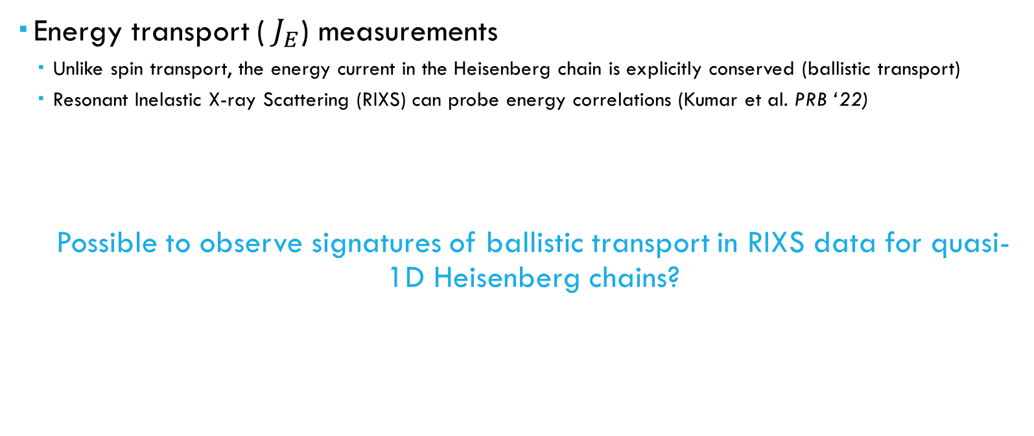
Future Directions
Energy transport (${ J}_{E}$) measurements
Unlike spin transport, the energy current in the Heisenberg chain is explicitly conserved (ballistic transport)
Resonant Inelastic X-ray Scattering (RIXS) can probe energy correlations (Kumar et al. PRB ‘22)
Possible to observe signatures of ballistic transport in RIXS data for quasi-1D Heisenberg chains?

Slide 24




Thanks!
Joel Moore

